Slide 1

Vue.js
Paris - 2023
Animated by : Mohammed BAHRI
(Developer & Web Trainer)

Slide 2
VUE.JS
Learn Vue.js
PROGRAM
Introduction
The essentials of view.js
Advanced aspects
More: Exploiting an API (REST)
Conclusion

Slide 3

WELCOME : Roundtable
Who are you, your job?
What are your professional goals?
What are your knowledge on the subject?

Slide 4
INTRODUCTION

Slide 5
Vue.js : Introduction
Vue.js (also called simply View), is an open-source JavaScript framework used to build user interfaces.
The library is used by Adobe, Alibaba and Gitlab.
Vue was created by Evan You after working for Google using AngularJS in several projects.

Slide 6

Vue.js : Introduction
Creator : Evan You (尤 雨 溪)
First version : February 11, 2014
Latest Version : 2.6.10 (March 20, 2019)
Deposit : https://github.com/vuejs/view
Written in Javascript
Type : JavaScript Framework
License : MIT License
Website : https://vuejs.org

Slide 7
Vue.js : Installation
<!DOCTYPE html>
<html>
<meta charset="utf-8"/>
<script src="https://unpkg.com/vue@next"></script>
<body>
</body>
</html>​

Slide 8
Vue.js : Instance
<!DOCTYPE html>
<html>
<meta charset="utf-8"/>
<script src="https://unpkg.com/vue@next"></script>
<body>
<div id="app">
{{ message }}
</div>
<script>
const app = Vue.createApp({
data() {
return {
message: 'Hello World!'
}
}
}).mount('#app')
</script>
</body>
</html>​

Slide 9
Vue.js : Data (attribute) : Array
<!DOCTYPE html>
<html>
<meta charset="utf-8"/>
<script src="https://unpkg.com/vue@next"></script>
<body>
<div id="app">
{{ cars[0] }}
{{ cars[1] }}
{{ cars[2] }}
</div>
<script>
const app = Vue.createApp({
data() {
return {
cars : ['BMW','RENAULT','PEUGEOT']
}
}
}).mount('#app')
</script>
</body>
</html>​

Slide 10
Vue.js : Data (attribute) : Object
<!DOCTYPE html>
<html>
<meta charset="utf-8"/>
<script src="https://unpkg.com/vue@next"></script>
<body>
<div id="app">
{{ cars.v1 }}
{{ cars.v2 }}
{{ cars.v3 }}
</div>
<script>
const app = Vue.createApp({
data() {
return {
cars: { v1:'BMW', v2: 'RENAULT', v3: 'PEUGEOT'}
}
}
}).mount('#app')
</script>
</body>
</html>

Slide 11

Vue.js : Exercise 1
Create an instance containing the name, age and occupation of a person.
Display information using expressions ({{ }}).
Example:

Slide 12
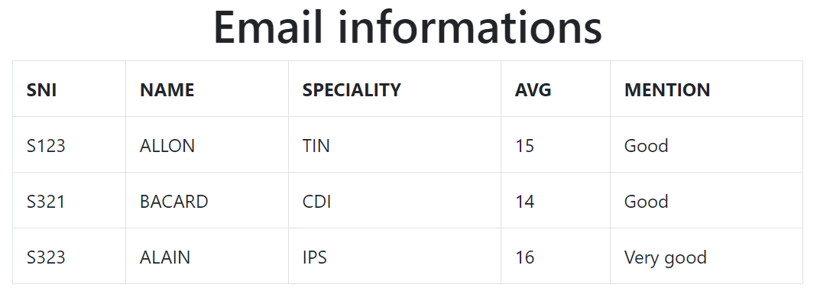
Vue.js : Exercise 2
Transform the table below into Vuejs data and then display it using bootsrap4.
Notes:
<!DOCTYPE html>
<html>
<meta charset="utf-8"/>
<link rel="stylesheet" href="https://stackpath.bootstrapcdn.com/bootstrap/4.3.1/css/bootstrap.min.css">
<script src="vue.js"></script>
<body>
<div id="app" class="container" align=center>
<h1>{{ parentMessage }}</h1>
<table class="table table-bordered">
<tr>
<th>SNI</th>
<th>NAME</th>
<th>SPECIALITY</th>
<th>AVG</th>
<th>MENTION</th>
</tr>
<tr>
<td> {{ items[0].nsi }} </td>
<td> {{ items[0].name }} </td>
<td> {{ items[0].speciality }} </td>
<td> {{ items[0].avg }} </td>
<td> {{ items[0].mention }} </td>
</tr>
</table>
<script>
var app = new Vue({
el: '#app',
data: {
parentMessage: 'Email informations',
items: [
{ nsi : 'S123',
name : "ALLON",
speciality : "TIN",
avg : 15,
mention : "Good"
}
]
}
})
</script>
</body>
</html>​

Slide 13
Vue.js : Function (Method)
<!DOCTYPE html>
<html>
<meta charset="utf-8"/>
<script src="https://unpkg.com/vue@next"></script>
<body>
<div id="app">
<p>{{ message }}</p>
<button v-on:click="reverseMessage">Reverse Message</button>
</div>
<script>
const app = Vue.createApp({
data() {
return {
message: 'Hello World!'
}
},
methods: {
reverseMessage: function () {
this.message = this.message.split('').reverse().join('')
}
}
}).mount('#app')
</script>
</body>
</html>​

Slide 14
Vue.js : Function (Method) with {{ … }}
<!DOCTYPE html>
<html>
<meta charset="utf-8"/>
<script src="https://unpkg.com/vue@next"></script>
<body>
<div id="app">
<p>{{ hello('Daniel') }}</p>
</div>
<script>
const app = Vue.createApp({
methods: {
hello: function (name) {
return 'Hello ' + name
}
}
}).mount('#app')
</script>
</body>
</html>​

Slide 15
Vue.js : Exercise 3
Create a method taking the name, age and occupation of a person as parameter and then returns them.
Call the method using expressions ({{ }}).
Example:

Slide 16
Vue.js : Exercise 4
Create an instance containing the name, age and occupation of a person.
Create a method (named constructor ()) to initialize the attributes of the instance.
Create a method (named display ()) to display the instance data.
Test the methods using expressions ({{ }}).
Example:

Slide 17
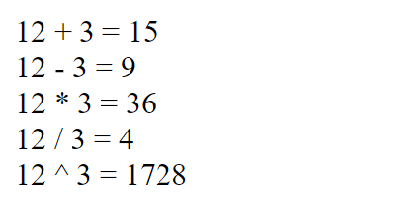
Vue.js : Exercise 5
Create an instance containing methods to do:
The addition, subtraction, multiplication and division of two parameters.
Test the methods using expressions ({{ }}).
Example:

Slide 18
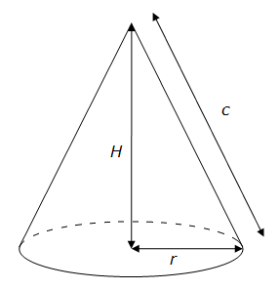
Vue.js : Exercise 6
Write a parameterized function that calculates the volume of a cone.
Rule: Volume = (Radius² * Height * Π) / 3

Slide 19
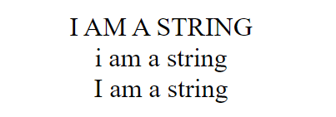
Vue.js : Exercise 7
Create an instance containing methods for formatting a string in :
Upper, Lower and capitalize case.
Test the methods using expressions ({{ }}).
Example:

Slide 20
Vue.js : V-Bind
<!DOCTYPE html>
<html>
<meta charset="utf-8"/>
<script src="https://unpkg.com/vue@next"></script>
<body>
<div id="app">
<p v-bind:title="message">
Hover your mouse over me for a few seconds to see my dynamically bound title!
</p>
</div>
<script>
const app = Vue.createApp({
data(){
return {
message: 'You loaded this page on ' + new Date().toLocaleString()
}
}
}).mount('#app')
</script>
</body>
</html>​

Slide 21
Vue.js : Bind (Shortcuts)
<!DOCTYPE html>
<html>
<meta charset="utf-8"/>
<script src="https://unpkg.com/vue@next"></script>
<body>
<div id="app">
<p :title="message">
Hover your mouse over me for a few seconds to see my dynamically bound title!
</p>
</div>
<script>
const app = Vue.createApp({
data(){
return {
message: 'You loaded this page on ' + new Date().toLocaleString()
}
}
}).mount('#app')
</script>
</body>
</html>​

Slide 22
Vue.js : Loop
<!DOCTYPE html>
<html>
<meta charset="utf-8"/>
<script src="https://unpkg.com/vue@next"></script>
<body>
<div id="app">
<span v-for="n in 10"> {{ n }} </span>
</div>
<script>
const app = Vue.createApp({
}).mount('#app')
</script>
</body>
</html>​

Slide 23
Vue.js : Loop
<!DOCTYPE html>
<html>
<meta charset="utf-8"/>
<script src="https://unpkg.com/vue@next"></script>
<body>
<ul id="app">
<li v-for="item in items">
{{ item }}
</li>
</ul>
<script>
const app = Vue.createApp({
data(){
return {
items: ['BMW', 'Renault']
}
}
}).mount('#app')
</script>
</body>
</html>​

Slide 24
Vue.js : Loop
<!DOCTYPE html>
<html>
<meta charset="utf-8"/>
<script src="https://unpkg.com/vue@next"></script>
<body>
<ul id="app">
<li v-for="(item, index) in items">
{{ index }} - {{ item }}
</li>
</ul>
<script>
const app = Vue.createApp({
data(){
return {
items: ['BMW', 'Renault']
}
}
}).mount('#app')
</script>
</body>
</html>​

Slide 25
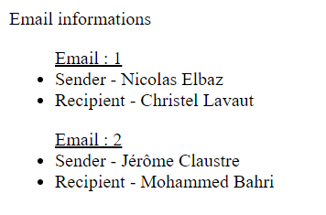
Vue.js : Exercise 8
items:
[
{ Sender:'Nicolas Elbaz', Recipient:'Christel Lavaut' },
{ Sender: 'Jérôme Claustre', Recipient: 'Mohammed Bahri' }
]

Slide 26

Vue.js : Exercise 9
Create a loop producing a horizontal line of 10 hearts.
Example:

Slide 27

Vue.js : Exercise 10
Use the loops to produce the rendering below :

